Slide 1
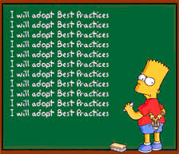
ISO/TC211 Ad hoc group on best practices for UML modelling
Shenzhen, China
2014-11-25
2014-11-26

Slide 2
Schedule
Tuesday October 25th 13:30-17:00
Coffee/Tea break 15:00-17:00
Wednesday October 26th 11:00-12:30
After PMG
Need for Wednesday meeting to be discussed at the end of the meeting today

Slide 3
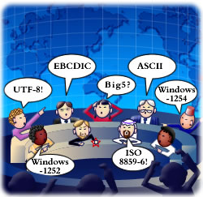
Nominated experts
ISO/TC211 AG Best practices for UML
Dr. Jean Brodeur, Canada
Mr. Clemens Portele, Germany
Mr. Stephen Desmond, New Zealand
Professor Serena Coetzee, South Africa
Mr. Antonio Federico Rodriguez Pascual, Spain
Ms. Heidi Vanparys, Denmark
Ms. Debbie Wilson, United Kingdom
Dr. Paul Scarponcini, United States
Mr. Michael Lutz, EC-JRC

Slide 4
Other ressources
ISO/TC211 AG Best practices for UML
Dr. John Herring, HMMG
Dr. Ted Haberman, XMG
Dr. Steve Richard, XMG
Mr. Rob Atkinson, OGC
Dr. Markus Seifert, Germany

Slide 5
Agenda
Welcome and introduction
Roll call of members
Approval of agenda
Progress report
Preliminary plan for the group
Presentation of the Livelink site
Result presentation – Wiki site
Topics to include (overview)
Discussions on UML Topics (details)
Revised action plan
Any other businesses
Close

Slide 6

Vision
UML models that can be understood by both humans and machines

Slide 7
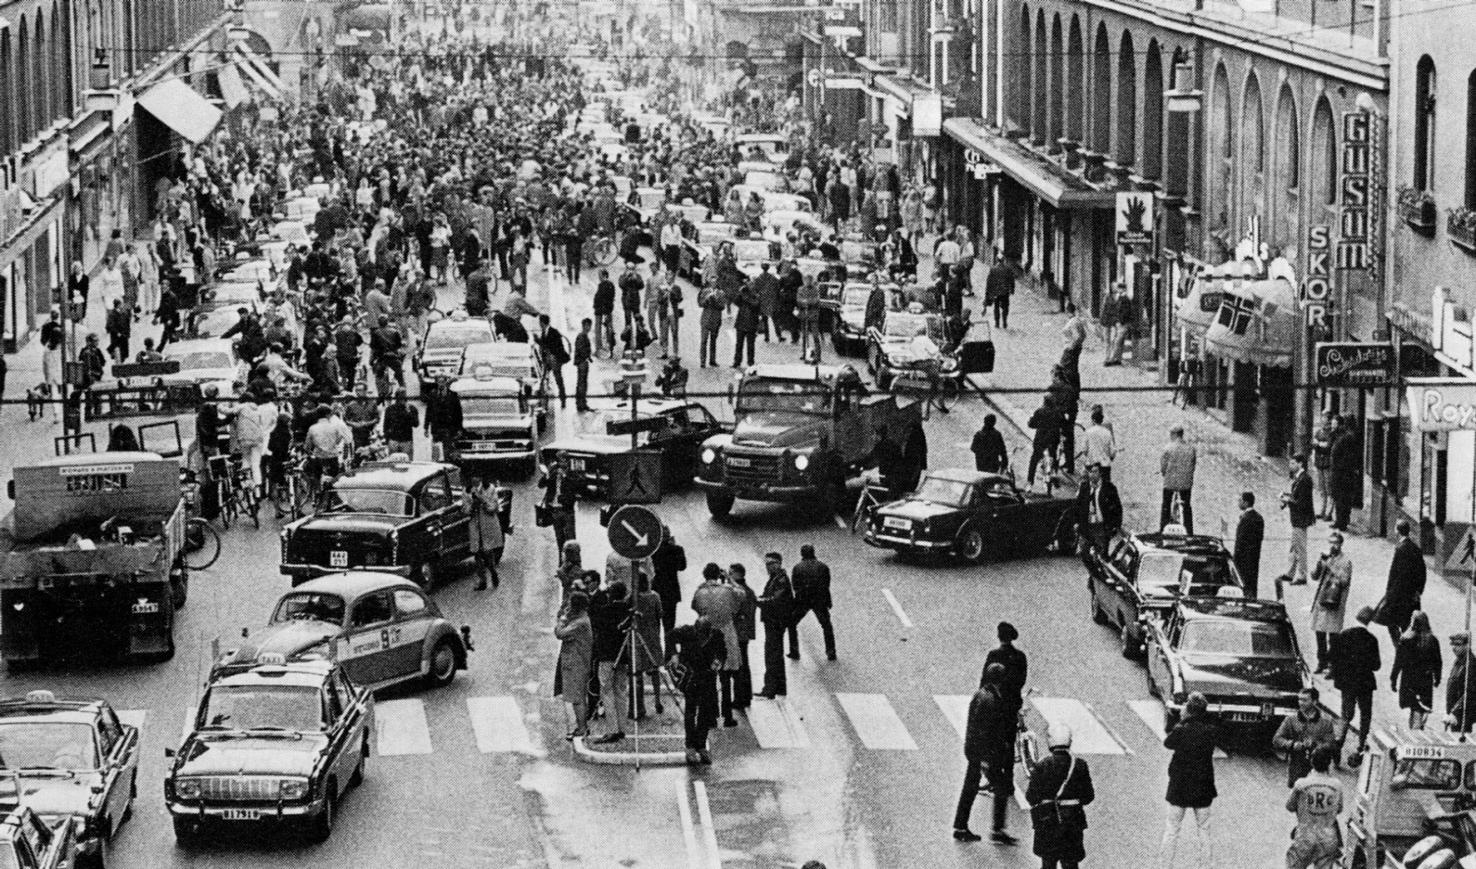
Progress report

Slide 8

Progress report
Call for members September 2014
Set up Livelink site
Investigating wiki oportunities
Initial discussions on subjects to include
Started preliminary wiki on Github

Slide 9
Preliminary plan
Before the meeting in Shenzhen:
Mail discussions on how to work
Mail and project place discussions on issues to include in the work
Physical meeting in Shenzhen
After the meeting in Shenzhen:
Starting to establish wiki
Describing specific issues
Mostly mail discussionss, web meetings when needed
Physical meeting in May/June 2015 (ISO/TC211 meeting week)
Next: We should continue the work up to the next meeting week in October/November 2015, but this is up to the plenary to decide

Slide 10
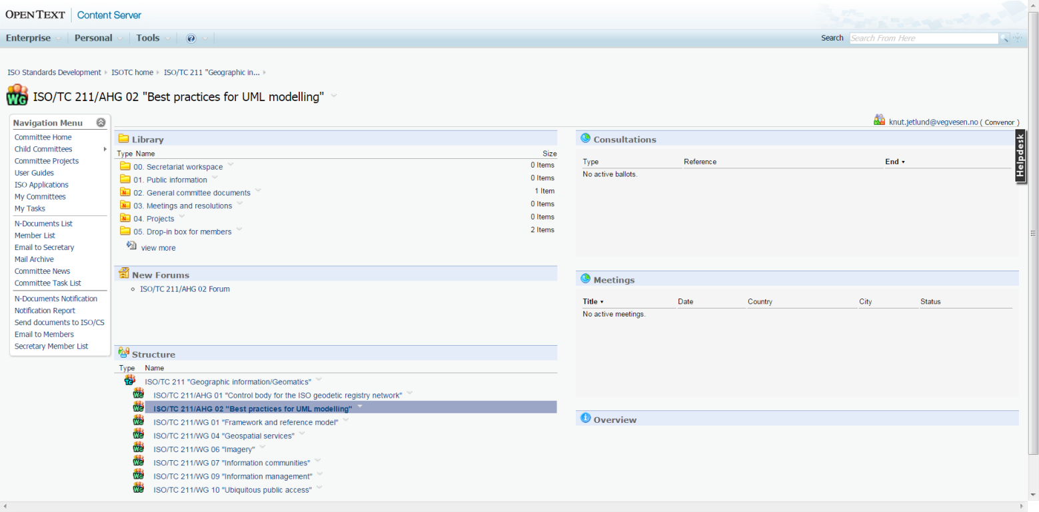
Livelink site
http://isotc.iso.org/livelink/livelink?func=ll&objId=16823611&objAction=browse&viewType=1

Slide 11
Result presentation – wiki site
OGC Internal
https://portal.opengeospatial.org/wiki/UMLdwg/WebHome
Login to view and edit
OGC External
http://external.opengeospatial.org/twiki_public/GML/WebHome
Open to view, login to edit
ISO TC/211 Wiki
To be discussed at AG Outreach
GitHub
https://github.com/ISO-TC211/UML-Best-Practices/wiki

Slide 12
Topics to include (overview)
Headlines
Basic UML
Modelling and design best practices
Relevant rules from standards
Implemetation issues
Level of abstraction
Conceptual models vs domain models vs application schemas vs implementation models

Slide 13
Basic UML
Short introduction to UML
Something like chapter 5.4 in ISO19136-GML
Introduction to the harmonized model
Loading the Harmonized Model
Basic Enterprise Architect usage

Slide 14
Relevant documents
11-107_OWS-8_Domain_Modelling_Cookbook.doc
INSPIRE UML repository tutorial.doc
UML issues.pdf
Loading the Harmonized Model

Slide 15
Modelling best practices
Class and attribute names and (not) prefixes
Abstract classes
Definitions
Constraints
Codelists and enumerations
Advanced: Subtyping and associating code lists (19107)
Connecting attributes to data types
Associations
Inheritance

Slide 16
Codelists – subtyping and associating

Slide 17
Design best practices
Illustrating classes from other standards
Tidy diagrams
How and when to view and hide attributes, operations and constraints
How and when to view and hide namespaces in diagrams
http://bellekens.com/uml-best-practices/
Composition vs Aggregation vs Association
Attribute or Association
5 rules for better UML diagrams

Slide 18
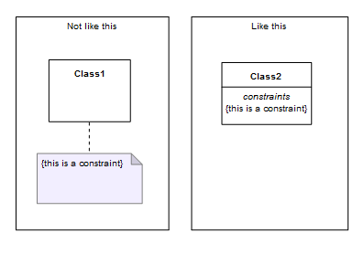
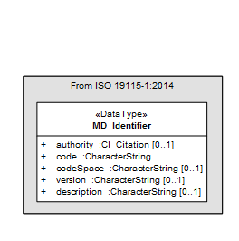
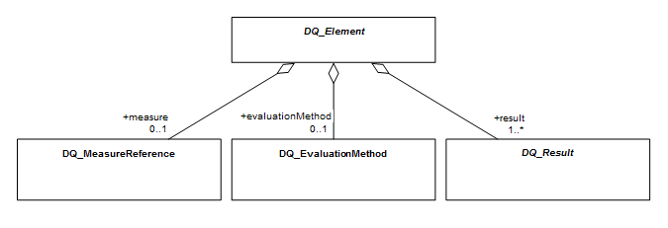
Designing models

Slide 19
Modelling and encoding rules
19103 - Conceptual schema language
19109 - Rules for application schema
19136 - GML (Annex E)
19139 - XML Schema Implementation
Summarize and harmonize for Best Practices

Slide 20
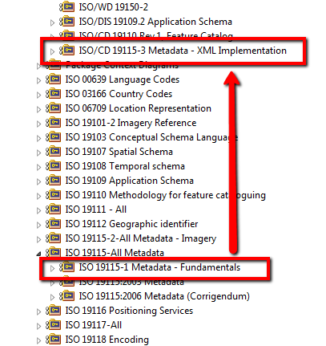
Implemetation issues
The iterative approach to standardization and implementation
Namespaces
Dependencies
Implementing and maintaining code lists

Slide 21
Topics to include (details)
Headlines
Basic UML
Modelling and design best practices
Relevant rules from standards
Implemetation issues

Slide 22
UML Topics (details)

Slide 23
Revised action plan

